Slide 1
Activities of Daily Living-Recognition with Wrist-Worn Accelerometer
Lecture: Deep Learning Architecture and Models
Professor: Prof. Dr. Kristian Kersting
Merve Bektas, Erik Helmut, Darya Nikitina, Moritz Meser

Slide 2
Agenda
Problem Statement
Approach
Evaluation

Slide 3











Problem Statement ”Analysis of human behavior recognition algorithms based on acceleration data” [1]
Recognition of Human Motion Primitives
Activities of Daily Living (ADL)
14 Activity Types
Algorithm based on deep learning
learn the features directly from the data
Wrist-Worn Accelerometer Data

Slide 4



Approach
Data
Model
Training

Slide 5
Approach
Data
The Dataset for ADL Recognition with Wrist-worn Accelerometer
Labelled accelerometer data recordings available for public usage for creation or validation of acceleration models
16 different volunteers recorded their performance of simple daily activities
14 activities
Examples: walking, brushing teeth, eating soup etc.
Collected by one tri-axial accelerometer on the right-wrist of the volunteer
Idea: Create a public testbench for a better comparison of human motion primitives detection algorithms

Slide 6



























Approach
Input
Sequence
Fully
connected Layer
Output
NLLLoss
2 recurrent LSTM Layers
$$A^{(0)}$$
$${\overset{→}{A}}^{(1)}$$
$${\overset{→}{A}}^{(2)}$$
$$k^{(0)}$$
$$y^{(0)}$$
P(y=0|x)
$$L$$
$$A^{(1)}$$
$${\overset{→}{A}}^{(1)}$$
$${\overset{→}{A}}^{(2)}$$
$$k^{(1)}$$
$$y^{(1)}$$
P(y=1|x)
Model
$$A^{(2)}$$
$${\overset{→}{A}}^{(1)}$$
$${\overset{→}{A}}^{(2)}$$
$$k^{(2)}$$
$$y^{(2)}$$
P(y=2|x)
$$A^{(i)}$$
$${\overset{→}{A}}^{(1)}$$
$${\overset{→}{A}}^{(2)}$$
$$A^{(T−1)}$$
$${\overset{→}{A}}^{(1)}$$
$${\overset{→}{A}}^{(2)}$$
$$A^{(T)}$$
$${\overset{→}{A}}^{(1)}$$
$${\overset{→}{A}}^{(2)}$$
$$k^{(255)}$$
$$y^{(13)}$$
P(y=13|x)
Hidden State
of last LSTM
Cell in Sequence
ReLU
Log-Softmax

Slide 7
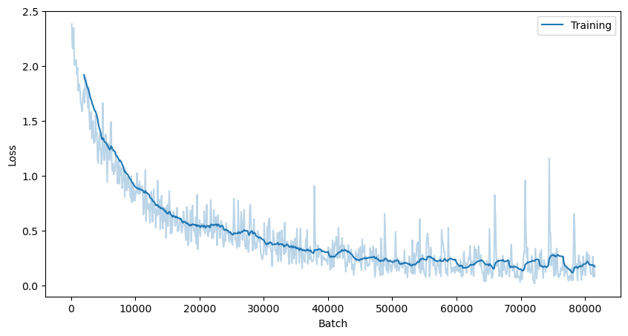
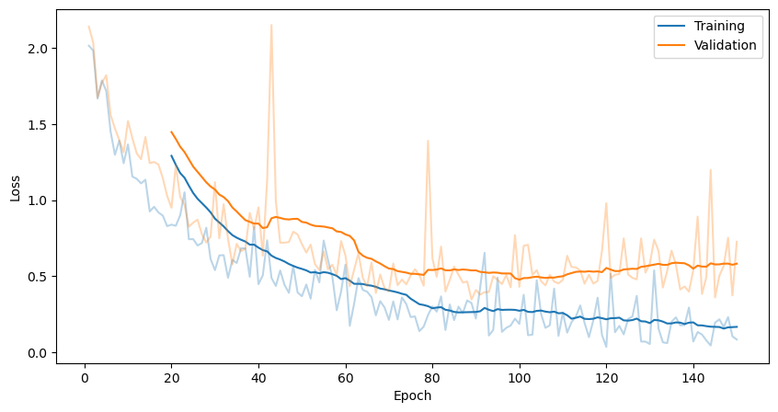
Approach
Optimizer: Adam
Learning Rate: 0.001
Batch Size: 1
Epochs: 50
Percentage of Data used for Training / Validation: 0.7 / 0.1
Training

Slide 8
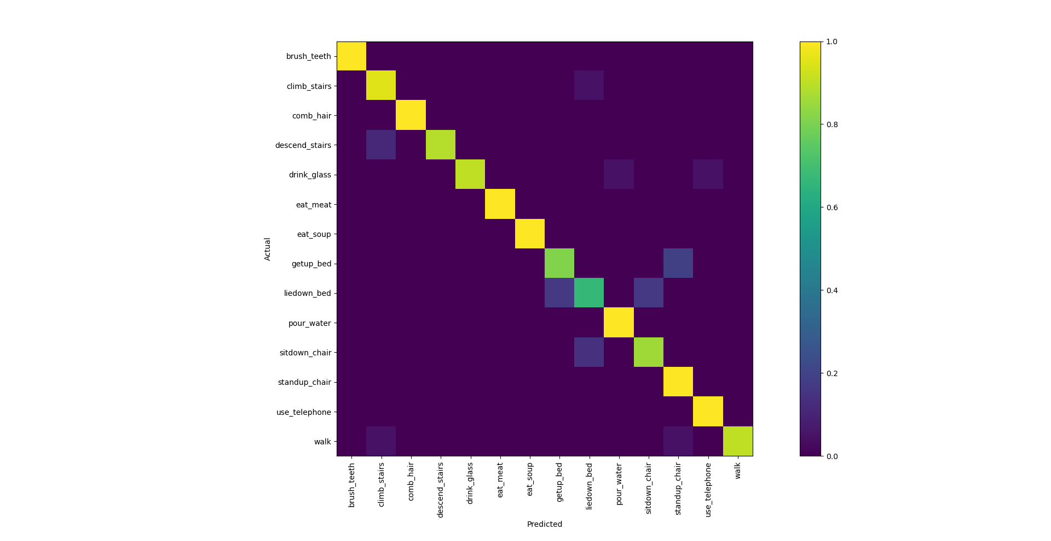
Evaluation
Accuracy: ~ 91.62%
Activity | TP (Base) | TN (Base) | TP (Ours) | TN (Ours)
Climb Stairs | 38.3% | 85.78% | 95.24% | 98.78%
Drink Water from a Glass | 90.91% | 86.59% | 90.48% | 100%
Pour Water | 95% | 71.55% | 100% | 99.63%
Sit down on chair | 0% | 100% | 85.71% | 98.72%
Stand up from chair | 35.71% | 93.96% | 100% | 98.17%

Slide 9
Conclusion and Further Improvements
Efficient and accurate tracking of human motion primitives
Low training and validation loss after training
High Accuracy of the Prediction
Possible Further Improvements
Test with different optimizers
Compare to other algorithms

Slide 10

Thank you for your attention!
You can find us on GitHub!

